Slide 1

Binary Classification of Boston Housing Prices
DM
by Dhruv Mane

Slide 2

INTRODUCTION
This presentation explores a binary classification task using the Boston Housing dataset, converting continuous house prices into above- or below-median categories. I implemented and evaluated two models: a baseline Gaussian Naive Bayes and a proposed Random Forest classifier. Both models are trained on standardized features, allowing a direct performance comparison in predicting whether a house price exceeds the median value.
Detailed metrics include accuracy, confusion matrices, and ROC-AUC scores, accompanied by visualizations to provide comprehensive insights on model effectiveness and reliability.
DM
by Dhruv Mane

Slide 3
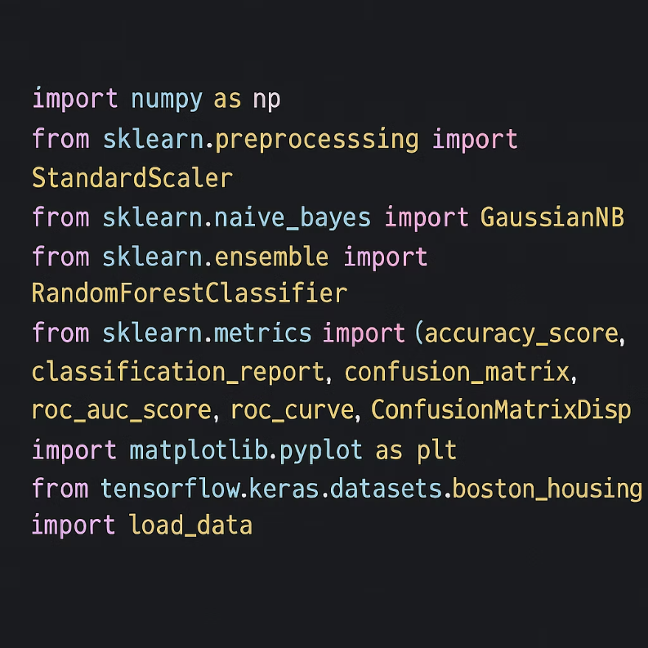

LIBRARIES IMPORTED

Slide 4

Data Preparation and Binary Labeling
Loading Dataset
Binary Label Creation
The Boston Housing dataset is loaded from TensorFlow Keras datasets, split into training and test samples with 13 features per sample.
I calculated the median of training house prices and create binary labels where prices above median are labeled as 1, otherwise 0.
Feature Scaling
Feature values are standardized using StandardScaler for normalized input across models, improving training stability and performance.

Slide 5
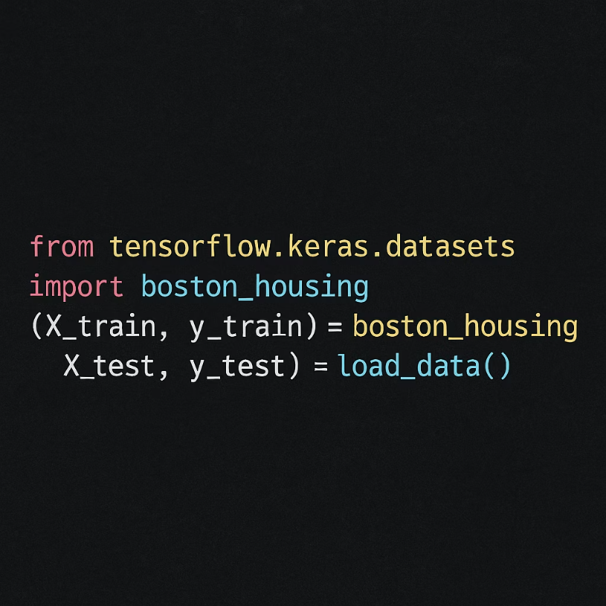

Slide 6
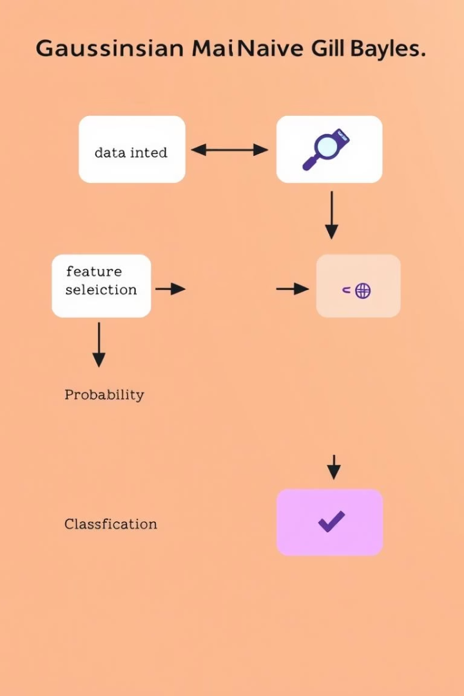
Baseline Model: Gaussian Naive Bayes
Model Characteristics
Gaussian Naive Bayes assumes feature independence and models each feature's distribution as Gaussian. It is computationally efficient and a good baseline for classification.
Performance Metrics
The baseline model achieves reasonable accuracy on the test set, with classification report indicating precision, recall, and F1-scores for both classes.

Slide 7
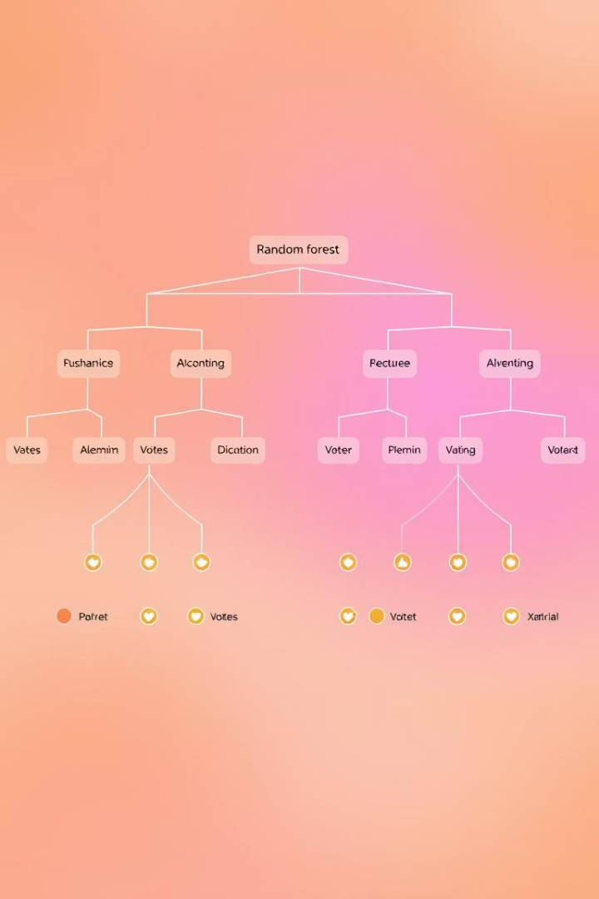
Proposed Model: Random Forest Classifier
Model Details
Random Forest is an ensemble of decision trees that improves predictive accuracy and controls overfitting through averaging multiple tree outputs.
Performance Comparison
The Random Forest model outperforms Naive Bayes in accuracy and detailed classification metrics, benefiting from its ability to capture nonlinear relationships.

Slide 8
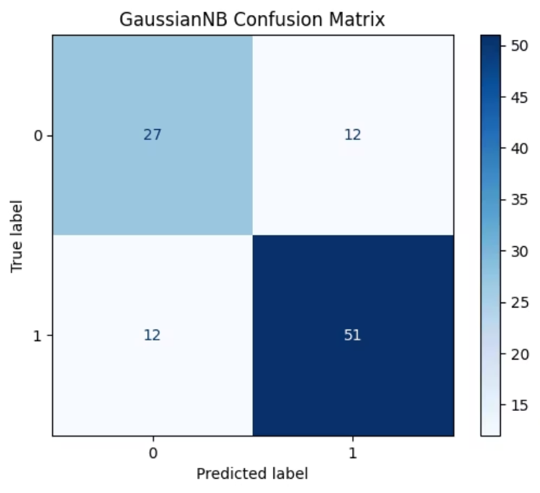
Confusion Matrices Analysis
Gaussian Naive Bayes
The confusion matrix shows the distribution of true positives, false positives, true negatives, and false negatives, revealing its classification weaknesses such as higher misclassification rate.

Slide 9
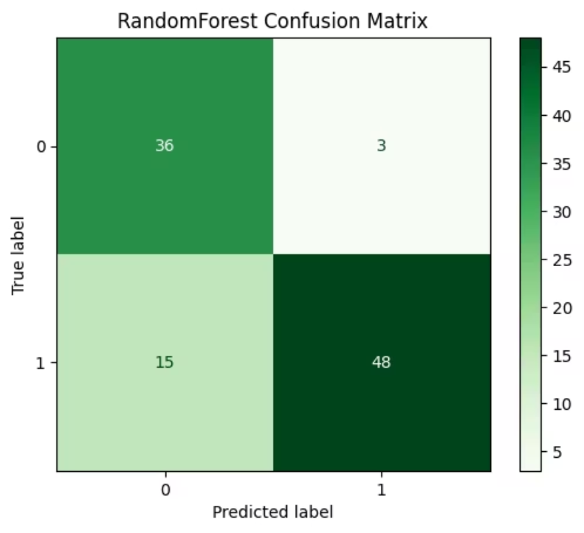
Random Forest
Random Forest confusion matrix presents fewer misclassifications, indicating better discrimination between above- and below-median price classes, reflecting improved reliability.

Slide 10
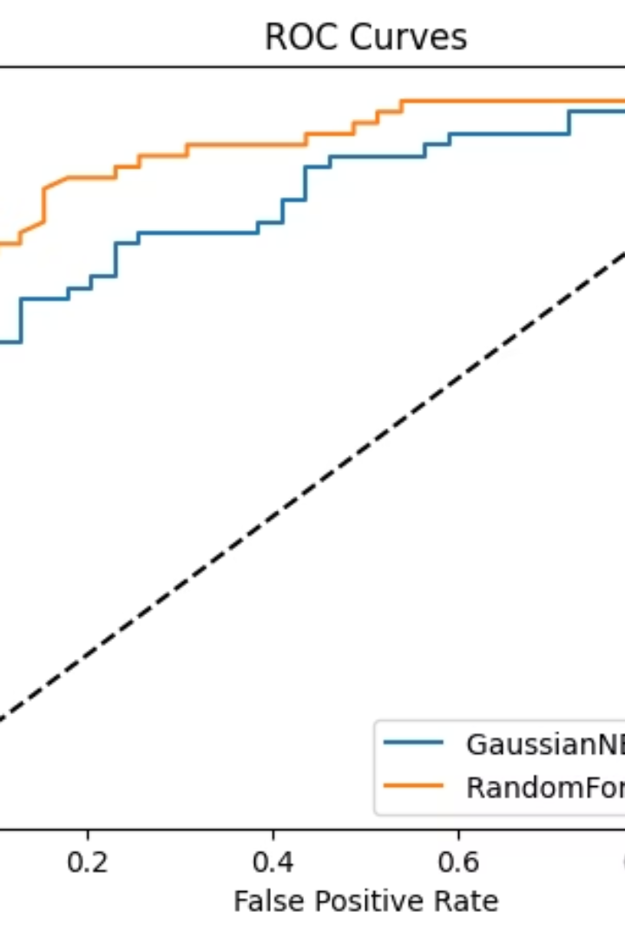

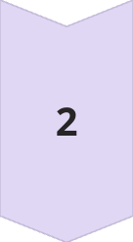

ROC Curve and AUC Comparison
ROC Curve Insights
ROC curves plot True Positive Rate against False Positive Rate, visually assessing classification trade-offs.
AUC Scores
Random Forest achieves higher AUC than GaussianNB, confirming stronger overall classification performance across thresholds.
Model Selection
Higher AUC indicates better ability to separate classes, making Random Forest preferred for this task.

Slide 11
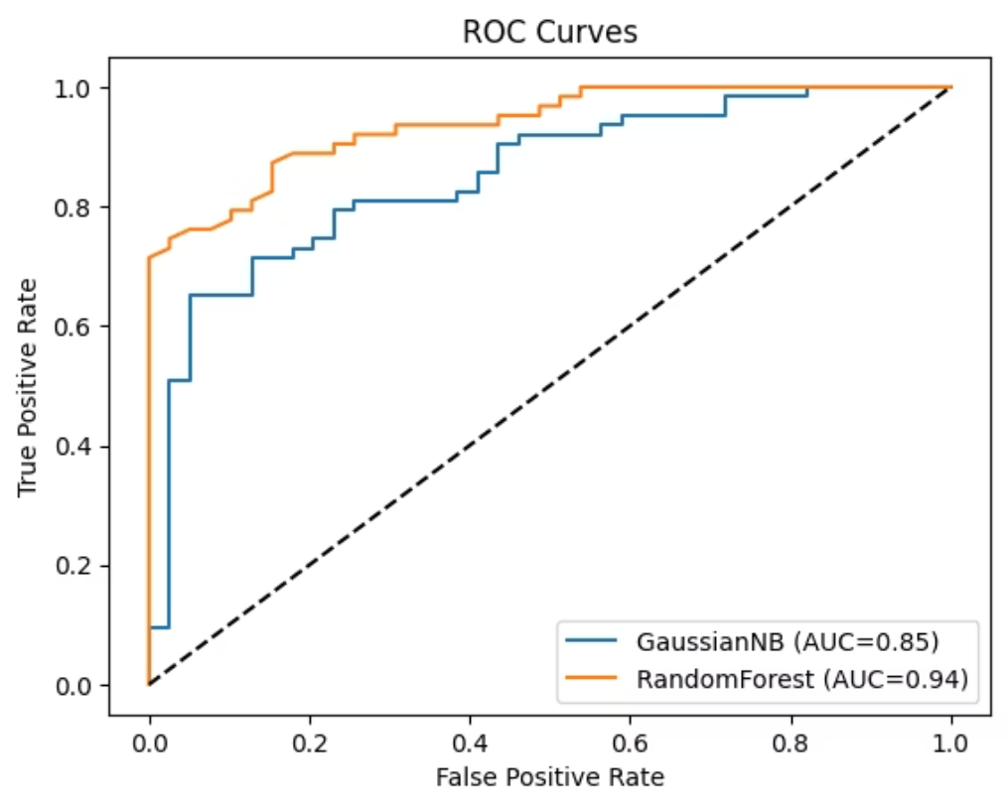

Slide 12
PROBLEM STATEMENT
Why is the Proposed Model (Random Forest) Better?
Handles Complex Relationships:
Random Forest captures nonlinear patterns and feature interactions, while Naive Bayes assumes independence and linearity (oversimplifying real-world data).
Higher Accuracy:
Random Forest achieved better test accuracy and F1-scores by reducing misclassifications (evident in confusion matrices).
Robust AUC Score:
Random Forest’s higher AUC (Area Under ROC Curve) indicates superior class separation across thresholds.
Reduced Overfitting:
Ensemble averaging in Random Forest generalizes better than Naive Bayes’ single Gaussian assumption.

Slide 13
Single Sample Prediction Function
Implementation
Use Case
A function is defined to predict the price class for an individual sample by scaling input features and generating probability-based predictions using the trained model.
This enables on-demand inference with confidence scores, critical for real-time applications and further decision making in production pipelines.

Slide 14

Key Takeaways and Next Steps
1
Summary
2
Recommendations
Random Forest outperforms Gaussian Naive Bayes on binary classification of Boston housing prices using scaled features and robust ensemble learning.
Consider further hyperparameter tuning, feature engineering, and exploration of advanced models like gradient boosting for improved accuracy.
3
Practical Application
Single-sample prediction function facilitates integration into larger systems for real-time price category predictions with confidence metrics.

Slide 15


